Slide 1


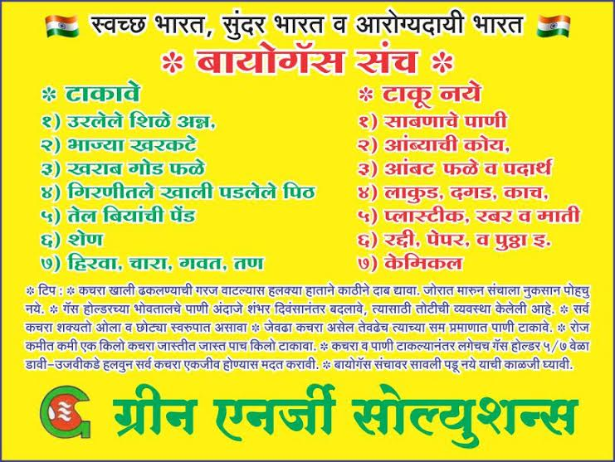


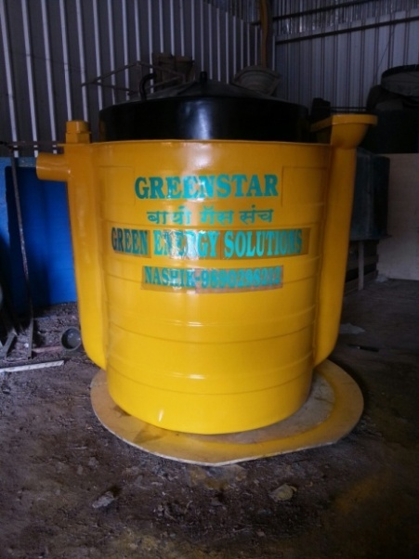
GREEN ENERGY SOLUTIONS
BIOGAS PRODUCTION FROM KITCHEN WASTE- GREEN STAR+
www.biogasnasik.com
Mr Santosh Shinde
Proprietor
Green Energy Solutions
GC-14 Thakkar Buzar, Nasik .
Cell No – 9890298212 , 8484005200

Slide 2
Overview
Biogas
Composition Of Biogas
Advantages And Disadvantages
Biochemical Reaction And Stages Of Anaerobic Digestion
Modes Of Operation
Types Of Anaerobic Digesters
Paper Presentation
www.biogasnasik.com

Slide 3
What is biogas?
Biogas Is A Methane Rich Flammable Gas That Results From The Decomposition Of Organic Waste Material
Biogas Is Produced By Anaerobic Digestion Or Fermentation Of Biodegradable Materials Such As Biomass, Manure, Sewage, Municipal Waste, Green Waste, Plant Material And Energy Crops.
Biogas Also Called As ‘Marsh Gas’
Biogas Is A Type Of Biofuel.
This Type Of Biogas Comprises Primarily Methane And Carbon Dioxide

Slide 4
Composition of biogas
www.biogasnasik.com
Biogas is generated by the activity of anaerobic bacteria
Composition depends on: the composition of raw material, organic loading to digesters, time and temperature of anaerobic digestion
Composition of biogas
Substances | Symbol | Percentage
Methane | CH₄ | 50 - 70
Carbon Dioxide | CO₂ | 30 - 40
Hydrogen | H₂ | 5 - 10
Nitrogen | N₂ | 1 - 2
Water vapour | H₂O | 0.3
Hydrogen Sulphide | H₂S | Traces

Slide 5
Advantages of biogas
Production of large amount of methane gas (ambient temperature storage)
Production of free flowing thick sludge
Odorless sludge
Sludge can be used as fertilizer and soil conditioner
Sanitary way for human and animal waste disposal
Conservation of scarce resources like wood
Low Cost
www.biogasnasik.com

Slide 6
GREEN ENERGY SOLUTION Info . Line +91 98902 98212
Disadvantages
Incorrect handling of liquid sludge causes pollution
Requires control and maintenance
Needs proper temperature condition
Use as a fuel requires removal of CO₂ and H₂S
www.biogasnasik.com

Slide 7

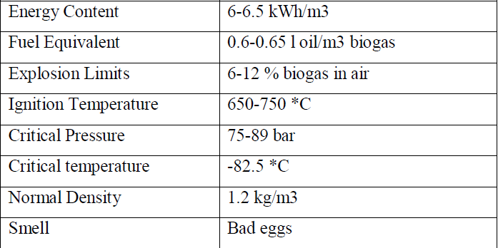
GENERAL FEATURES OF BIOGAS

Slide 8

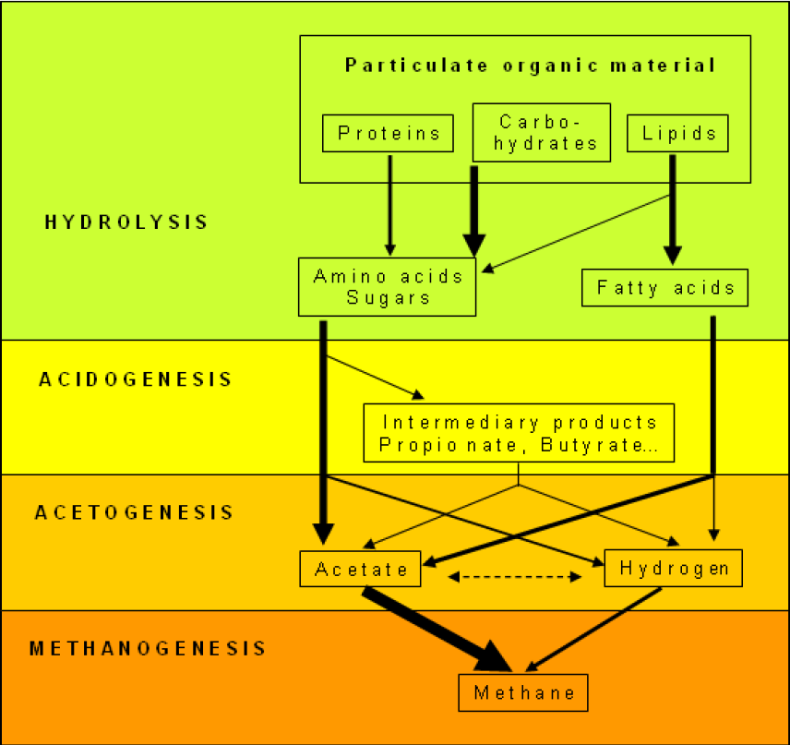
Flow chart of anaerobic digestion

Slide 9
Batch-fed System
The simplest design.
Low cost.
The feedstock is loaded one batch at time.
Irregular biogas production.
Can operate on high solid content.
Requires manual labor.
www.biogasnasik.com

Slide 10
Types of digesters
A typical biogas system consists of the following components:
(1) Manure collection
(2) Anaerobic digester
(3) Effluent storage
(4) Gas handling
(5) Gas use.
TWO MAIN TYPES:
Digesters utilizing dispersed growth of bacteria
Digesters utilizing attached growth of bacteria
www.biogasnasik.com

Slide 11
DISPERSED GROWTH DIGESTERS
Fixed dome digester
Floating gas holder digester (Indian)
Plug flow digester (horizontal displacement)
Bag digester (Taiwan and Korea)
Separate gas holder digester
Conventional digester
www.biogasnasik.com

Slide 12

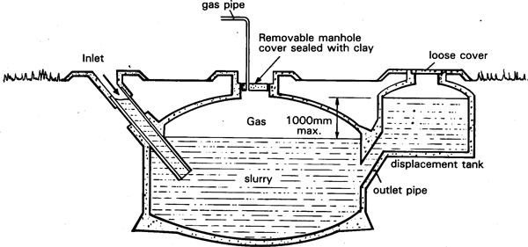
Fixed dome digester
Drumless digester.
Underground brick masonry compartment (fermentation chamber) with a dome on the top for gas storage.
The fermentation chamber and gas holder are combined as one unit.
Eliminates the use of costlier mild steel gas holder which is susceptible to corrosion.
20 to 50 years.

Slide 13

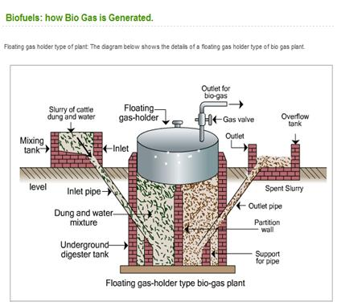
Floating gas holder digester
Jashu Bhai J Patel developed a design of floating drum biogas plant
Popularly known as Gobar Gas plant.
In this design, the digester chamber is made of brick masonry in cement mortar.
A mild steel drum is placed on top of the digester to collect the biogas produced from the digester. Thus, there are two separate structures for gas production and collection.

Slide 14
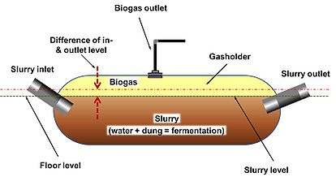
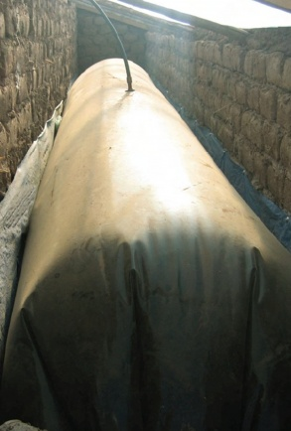
Bag Biodigester
It consists of a long cylinder made of PVC or red mud plastic.
The bag digester was developed to solve the problems experienced with brick and metal digesters.

Slide 15
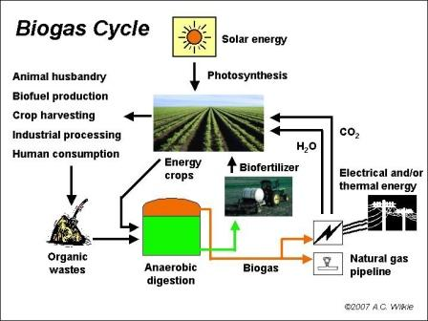

Slide 16

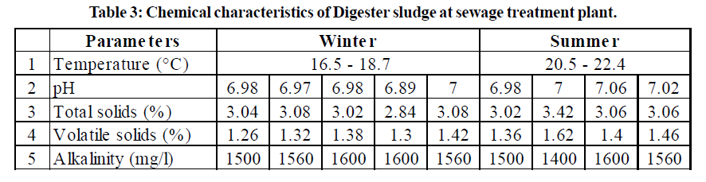
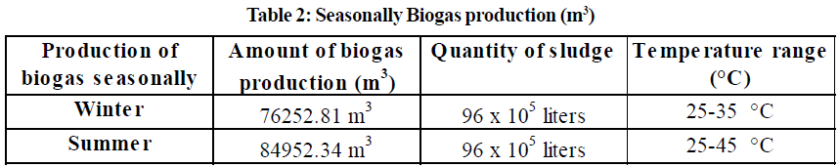
Results
The present study was done in the months of winter and summer and the sampling were done seasonally from the sewage treatment plant.
Raw sewage consists of organic and inorganic solids in dissolved and suspended form with 90-99.9% of water

Slide 17
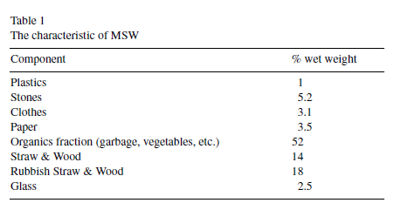
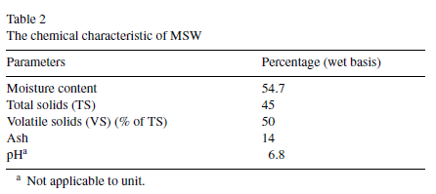
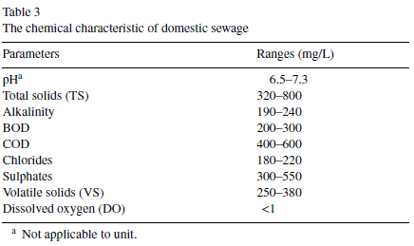
Results

Slide 18
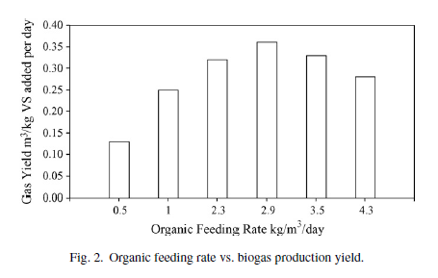
The digester was operated at different organic feeding rates of 0.5, 1.0, 2.3, 2.9, 3.5 and 4.3 kg of volatile solids (VS)/m3 of digester slurry per day.
Biogas generation was enhanced by the addition of domestic sewage to MSW.
The maximum biogas production of 0.36m3/kg of VS added per day occurred at the optimum organic feeding rate of 2.9 kg of VS/m3/day.

Slide 19

www.biogasnasik.com

Slide 20
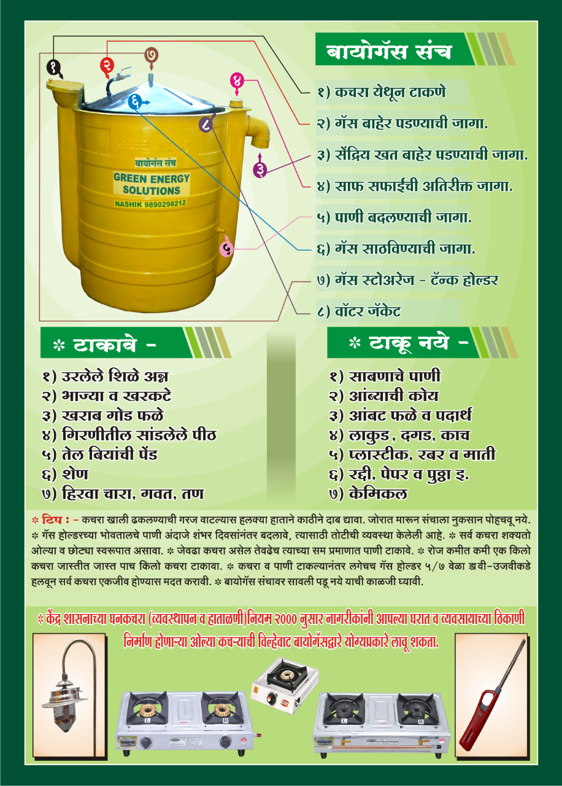
www.biogasnasik.com

Slide 21


Slide 22
THANK YOU
www.biogasnasik.com

